Slide 1



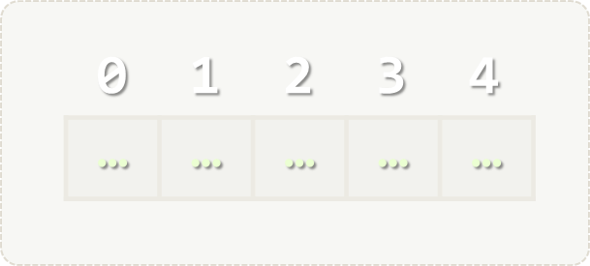
Arrays and Lists
Array and List methods. Array and List Algorithms.
Programming Fundamentals
SoftUni Team
Technical Trainers
Software University
http://softuni.bg

Slide 2



Table of Contents
Defining and Using Arrays and Lists
Working with Arrays and Lists
Reading Input Collections from Console
Using the Collections’ methods
Basic algorithms
Searching in Arrays and Lists
Sorting Arrays and Lists

Slide 3
Have a Question?
sli.do 123321

Slide 4
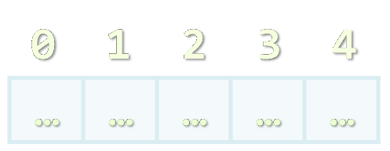
Arrays
Working with Arrays of Elements

Slide 5
What are Arrays?
In programming, array is a sequence of elements
Elements are numbered from 0 to Length-1
Elements are of the same type (e.g. integers)
Arrays have fixed size (Array.Length) – cannot be resized
0 1 2 3 4
Element index
Array of 5 elements
… | … | … | … | …
Element of an array

Slide 6
Working with Arrays
All elements are initially == 0
Allocating an array of 10 integers:
Assigning values to the array elements:
Accessing array elements by index:
int[] numbers = new int[10];
The Length holds the number of array elements
for (int i = 0; i < numbers.Length; i++)
numbers[i] = 1;
The [] operator accesses elements by index
numbers[5] = numbers[2] + numbers[7];
numbers[10] = 1; // IndexOutOfRangeException

Slide 7
Example: Days of Week
The days of week can be stored in array of strings:
string[] days = {
"Monday",
"Tuesday",
"Wednesday",
"Thursday",
"Friday",
"Saturday",
"Sunday"
};
Expression | Value
days[0] | Monday
days[1] | Tuesday
days[2] | Wednesday
days[3] | Thursday
days[4] | Friday
days[5] | Saturday
days[6] | Sunday

Slide 8
Problem: Day of Week
Enter a day number [1…7] and print the day name (in English) or "Invalid day!"

Slide 9
Solution: Day of Week
string[] days = { "Monday", "Tuesday", "Wednesday", "Thursday", "Friday", "Saturday", "Sunday" };
int day = int.Parse(Console.ReadLine());
if (day >= 1 && day <= 7)
Console.WriteLine(days[day - 1]);
else
Console.WriteLine("Invalid day!");

Slide 10
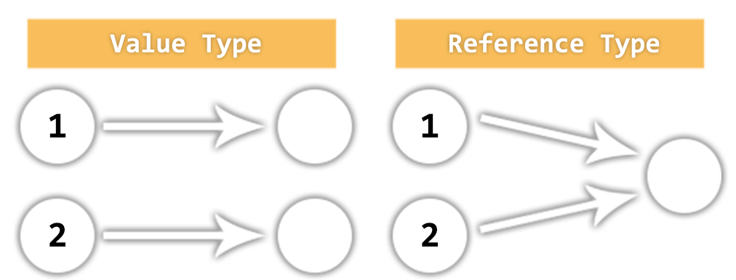
Value vs. Reference Types
Memory Stack and Heap

Slide 11
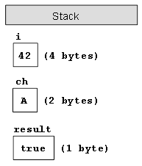
Value Types
Value type variables hold directly their data
int, float, double, bool, char, DateTime, BigInteger, …
msdn.microsoft.com/library/bfft1t3c.aspx
Each variable has its own copy of the data
int i = 42;
char ch = 'A';
bool result = true;

Slide 12
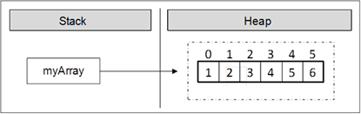
Reference Types
Reference type variables hold reference (pointer / memory address) of the data itself
string, int[], char[], string[], Random, instances of classes, interfaces, delegates
Two reference type variables can reference the same object
Operations on both variables access / modify the same data
var arr = new int[] {
1, 2, 3, 4, 5, 6 };

Slide 13
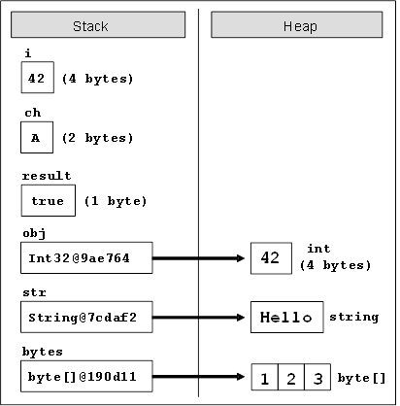
Value Types vs. Reference Types
int i = 42;
char ch = 'A';
bool result = true;
object obj = 42;
string str =
"Hello";
byte[] bytes =
{ 1, 2, 3 };

Slide 14
Value vs. Reference Types

Slide 15
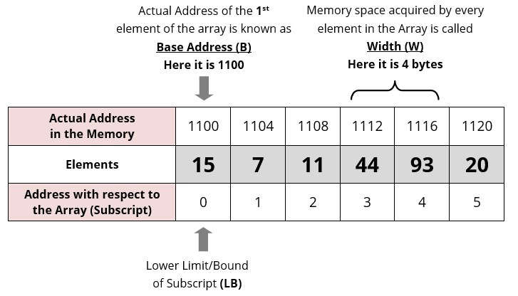
Reference Types
Address of A [ I ] = B + W * ( I – LB )
B = Base address
W = Storage Size of one element stored in the array (in byte)
I = Subscript of element whose address is to be found
LB = Lower limit / Lower Bound of subscript, if not specified
assume 0 (zero)

Slide 16

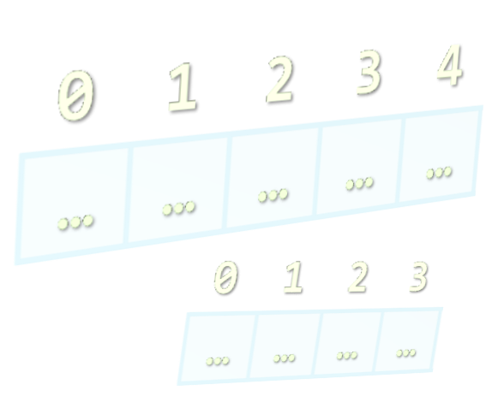
Reading and Printing Arrays
Using String.Split() and for loops

Slide 17
Reading Arrays From the Console
First, read the array length from the console:
Next, create an array of given size n and read its elements:
int n = int.Parse(Console.ReadLine());
int[] arr = new int[n];
for (int i = 0; i < n; i++)
{
arr[i] = int.Parse(Console.ReadLine());
}

Slide 18
Reading Array Values From a Single Line
Arrays can be read from a single line of space separated values:
2 8 30 25 40 72 -2 44 56
string.Split(' ') splits string by space and produces string[]
string values = Console.ReadLine();
string[] items = values.Split(' ');
int[] arr = new int[items.Length];
for (int i = 0; i < items.Length; i++)
arr[i] = int.Parse(items[i]);

Slide 19
Printing Arrays on the Console
To print all array elements, a for-loop can be used
Separate elements with white space or a new line
Example:
string[] arr = {"one", "two", "three", "four", "five"};
// Process all array elements
for (int index = 0; index < arr.Length; index++)
{
// Print each element on a separate line
Console.WriteLine("arr[{0}] = {1}", index, arr[index]);
}

Slide 20
Printing Arrays String.Join(…)
Use string.Join(separator, array):
int[] arr = { 1, 2, 3 };
Console.WriteLine(string.Join(", ", arr)); // 1, 2, 3
string[] strings = { "one", "two", "three", "four" };
Console.WriteLine(string.Join(" - ", strings)); // one - two - three - four

Slide 21
Problem: Rotate Array of Strings
Read an array of strings (space separated values), rotate it to the right and print its rotated elements:
Rotating array elements:
a b c d e
e a b c d
soft uni hi
hi soft uni
a
b
c
d
e

Slide 22
Solution: Rotate Array of Strings
var array = Console.ReadLine().Split().ToArray();
var rotatedArray = new string[array.Length];
for (int i = 0; i < array.Length - 1; i++)
rotatedArray[i + 1] = array[i];
var lastElement = array[rotatedArray.Length - 1];
rotatedArray[0] = lastElement;
Console.WriteLine(string.Join(" ", rotatedArray));

Slide 23
Problem: Odd Numbers at Odd Positions
Read a list of integers and print the odd numbers at the odd positions (indexes).
2 3 5 2 7 9 -1 -7
5 0 1 2
2 3 55 2 4 1
Index 1 -> 3
Index 5 -> 9
Index 7 -> -7
(no output)
Index 1 -> 3
Index 5 -> 1

Slide 24
Solution: Odd Numbers at Odd Positions
var stringArray = Console.ReadLine().Split().ToArray();
var array = new string[stringArray.Length];
// Convert string array to int array
for (int i = 0; i < array.Length; i++)
array[i] = int.Parse(stringArray[i]);
for (int i = 0; i < array.Length; i++)
{
if (i % 2 == 1 && Math.Abs(array[i] % 2) == 1)
Console.WriteLine($"Index {i} -> {array[i]}");
}
check for odd index
check for odd element

Slide 25
Problem: Array Contains Element
Write a program which checks if element is contained in array:
5
1 2 3 4 5
yes
11
8 7 7 9 6 2 2
no
2314
99 7 8 6 2314 2
yes

Slide 26
Solution: Array Contains Element
var element = int.Parse(Console.ReadLine());
var arr = Console.ReadLine()
.Split().Select(int.Parse).ToArray();
var containsElement = false;
for (int i = 0; i < arr.Length; i++)
if (arr[i] == element)
containsElement = true; break;
if (containsElement)
Console.WriteLine("yes");
else
Console.WriteLine("no");

Slide 27

Arrays
Live Exercises in Class (Lab)

Slide 28
Lists
Arrays with Variable Length

Slide 29
List<T> – Overview
List<T> holds a list of elements of any type T
var names = new List<string>(); // Create a list of strings
names.Add("Peter");
names.Add("Maria");
names.Add("George");
foreach (var name in names)
Console.WriteLine(name); names.Remove("Maria");
Console.WriteLine(
String.Join(", ", names));
var nums = new List<int> {
10, 20, 30, 40, 50, 60};
nums.RemoveAt(2);
nums.Add(100);
nums.Insert(0, -100);
Console.WriteLine(
String.Join(", ", nums));

Slide 30
List<T> – Data Structure
List<T> holds a list of elements (like array, but extendable)
Provides operations to add / insert / remove / find elements:
Add(element) – adds an element to the List<T>
Count – number of elements in the List<T>
Remove(element) – removes an element (returns true / false)
RemoveAt(index) – removes element at index
Insert(index, element) – inserts an element to given position
Contains(element) – determines whether an element is in the list
Sort() – sorts the array in ascending order

Slide 31
Add() – Appends an Element
10
5
2
List<int>
0
1
2
Count:
3

Slide 32
Remove() – Deletes an Element
10
List<int>
2
Count:
3
2
10
5

Slide 33
Remove() – Deletes an Element
Insert() – Inserts an Element at Position
-5
List<int>
3
Count:
2
2
5

Slide 34
Reading Lists from the Console
Using for loop or String.Split()

Slide 35
Reading List Values from a Single Line
Lists can be read from a single line of space separated values:
string.Split(' ') splits string by space and produces a collection
2 8 30 25 40 72 -2 44 56
string values = Console.ReadLine();
List<string> items = values.Split(' ').ToList();
List<int> nums = new List<int>();
for (int i = 0; i < items.Count; i++)
nums.Add(int.Parse(items[i]));
Convert a collection into List
Do everything at once
var items = Console.ReadLine().Split(' ') .Select(int.Parse).ToList();

Slide 36
Printing Lists on the Console
Printing a list using a for-loop:
Printing a list using a String.Join(…):
List<string> list = new List<string>() {
"one", "two", "three", "four", "five", "six"};
for (int index = 0; index < list.Count; index++)
Console.WriteLine("arr[{0}] = {1}", index, list[index]);
List<string> list = new List<string>() {
"one", "two", "three", "four", "five", "six"};
Console.WriteLine(String.Join("; ", list));

Slide 37
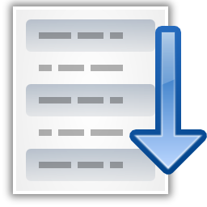


Sorting Lists and Arrays

Slide 38
Sorting Lists
Sorting a list == reorder its elements incrementally
List items should be comparable, e.g. numbers, strings, dates, …
var names = new List<string>() {"Nakov", "Angel", "Ivan", "Atanas", "Boris" };
names.Sort();
Console.WriteLine(string.Join(", ", names));
// Angel, Atanas, Boris, Ivan, Nakov
names.Sort(); names.Reverse();
Console.WriteLine(string.Join(", ", names));
// Nakov, Ivan, Boris, Atanas, Angel
Sort in natural (ascending) order
Sort in descending order

Slide 39
Problem: Sort Numbers
Read a list of decimal numbers and sort them
8 2 7 3
2 <= 3 <= 7 <= 8
1 1
1 <= 1
2 4 -9
-9 <= 2 <= 4
1 -0.5
-0.5 <= 1

Slide 40
Solution: Sort Numbers
List<double> nums =
Console.ReadLine().Split(' ')
.Select(double.Parse).ToList();
nums.Sort();
Console.WriteLine(string.Join(" <= ", nums));
Read the list of numbers
Sort the list
Print the list

Slide 41
Problem: Largest N Elements
Read a list of integers and print the 3 largest elements in descending order:
5 3 4 1 2
3
5 4 3
11 872 673 1 2
2
872 673
11 52 43 12 1 6
4
52 43 12 11

Slide 42
Solution: Largest N Elements
var arr = Console.ReadLine()
.Split().Select(int.Parse).ToList();
var n = int.Parse(Console.ReadLine());
// todo: sort list (in descending order)
// todo: initialize a list for the result
for (int i = 0; i < n; i++)
{
largestNElements.Add(arr[i]);
}
Console.WriteLine(string.Join(" ", largestNElements));

Slide 43
Lists – Exercises
Live Exercises in Class (Lab)

Slide 44

Summary
Arrays hold a sequence of elements
Elements are numbered from 0 to length-1
Lists hold a sequence of elements (variable-length)
Can add / remove / insert elements at runtime
int[] numbers = new int[10];
int[] nums = new int[] { 1, 2, 3 };
var numbers = new List<int>(); numbers.Add(5); // {5}
numbers.Add(3); // {5, 3}
numbers.Remove(5) // {3}

Slide 45







Progr. Fund. – Arrays and Lists
https://softuni.bg/trainings/1764/fundamentals-of-programming-with-csharp

Slide 46
License
This course (slides, examples, demos, videos, homework, etc.) is licensed under the "Creative Commons Attribution-NonCommercial-ShareAlike 4.0 International" license

Slide 47





Trainings @ Software University (SoftUni)
Software University – High-Quality Education, Profession and Job for Software Developers
softuni.bg
Software University Foundation
http://softuni.foundation/
Software University @ Facebook
facebook.com/SoftwareUniversity
Software University Forums
forum.softuni.bg

